Slide 1
Reconstruction
Notes:
This slide deck corresponds with Reconstruction- Lesson 10. Throughout these slides, the teacher notes will be utilized with teacher notes and helpful information for the teacher displaying this lesson plan.

Slide 2
Notes:
This slide is currently hidden. However, if this would be a useful aid to your students, you can reveal it. When students see these colors, it should signal what they are doing. ​

Slide 3
Essential Question
How did the United States attempt to reconstruct itself after the Civil War to create a more just society for everyone?

Slide 4
Guiding Questions
How did the Reconstruction amendments try to support justice for Black Americans?
How did the goals of bringing the country back together change over time?
How do the successes and failures of the Freedmen’s Bureau illustrate the challenges of achieving justice through Reconstruction?

Slide 5
Learning Objectives
I can define justice as a principle and a virtue.
I can identify cause and effect in historical events.
I can investigate primary source texts and images.
I can engage in historical analysis through writing.
I can create a video of my historical analysis.

Slide 6
Content Objectives
I can describe the intention and impact of the Thirteenth, Fourteenth, and Fifteenth Amendments.
I can describe the effects of President Lincoln's assassination on Reconstruction.
I can explain the purpose and effects of the Freedmen’s Bureau on freed Blacks in the South after the Civil War.

Slide 7
Vocabulary Word Study
Lincoln’s Second Inaugural Address Primary Source
Reconstruction Amendments Primary Sources, Supporting a Statement with Evidence
Lesson Reading and Annotation Activity, Planning a Historical Analysis
Freedmen’s Bureau Chalk Talk, Writing a Historical Analysis
Historical Analysis Selfie Video
Self-Assessment and Artifact Show and Tell

Slide 8
Notes:
Slides 9-11 correspond with the Anticipate section of the lesson plan. Students will need one or two copies of Handout A. Approximately 30-45 minutes.

Slide 9
Vocabulary Word Study
Follow the prompts to study the virtue of justice.
Notes:
Provide students with Handout A and materials (pencils, coloring utensils, and dictionaries or devices). Have students complete Word Studies for justice

Slide 10
Vocabulary Word Study
Follow the prompts to study the principle of justice.
Notes:
When students complete the second word study, 1-3 students will share their writing for each section of the organizer. More support for student differentiation is in the teacher lesson plan. Discussion Questions follow.

Slide 11
Discussion Questions
What are some examples of justice?
An individual can exhibit justice, as can an institution like a government. How is justice in these two instances different? How are they similar?
Can you have a just government if people don’t act justly?
How does someone act justly, or with justice?
When is justice needed to repair a relationship?
Notes:
Whole group discussion. In the lesson plan, there are ways to make justice easier to understand for students. Additionally, there is language to connect the vocabulary terms to the rest of the lesson.

Slide 12
Notes:
Slides 13-17 correspond with the Engage section of the lesson plan. Students will need Handout B. Approximately 20-30 minutes.

Slide 13
Lincoln's Second Inaugural Address
What challenges did the United States face in bringing the country back together and dealing with the damage of the Civil War?
Notes:
Display the prompt or assign students to write to respond to the prompt. Record student responses on the classroom board in a bubble map. Sample responses are included in the teacher lesson plan.

Slide 14
Text Investigation
Read the context paragraph on Handout B.
Make a prediction at the bottom of the page.
Notes:
Pair students and distribute Handout B: Lincoln's Second Inaugural Address. Review the instructions together.

Slide 15
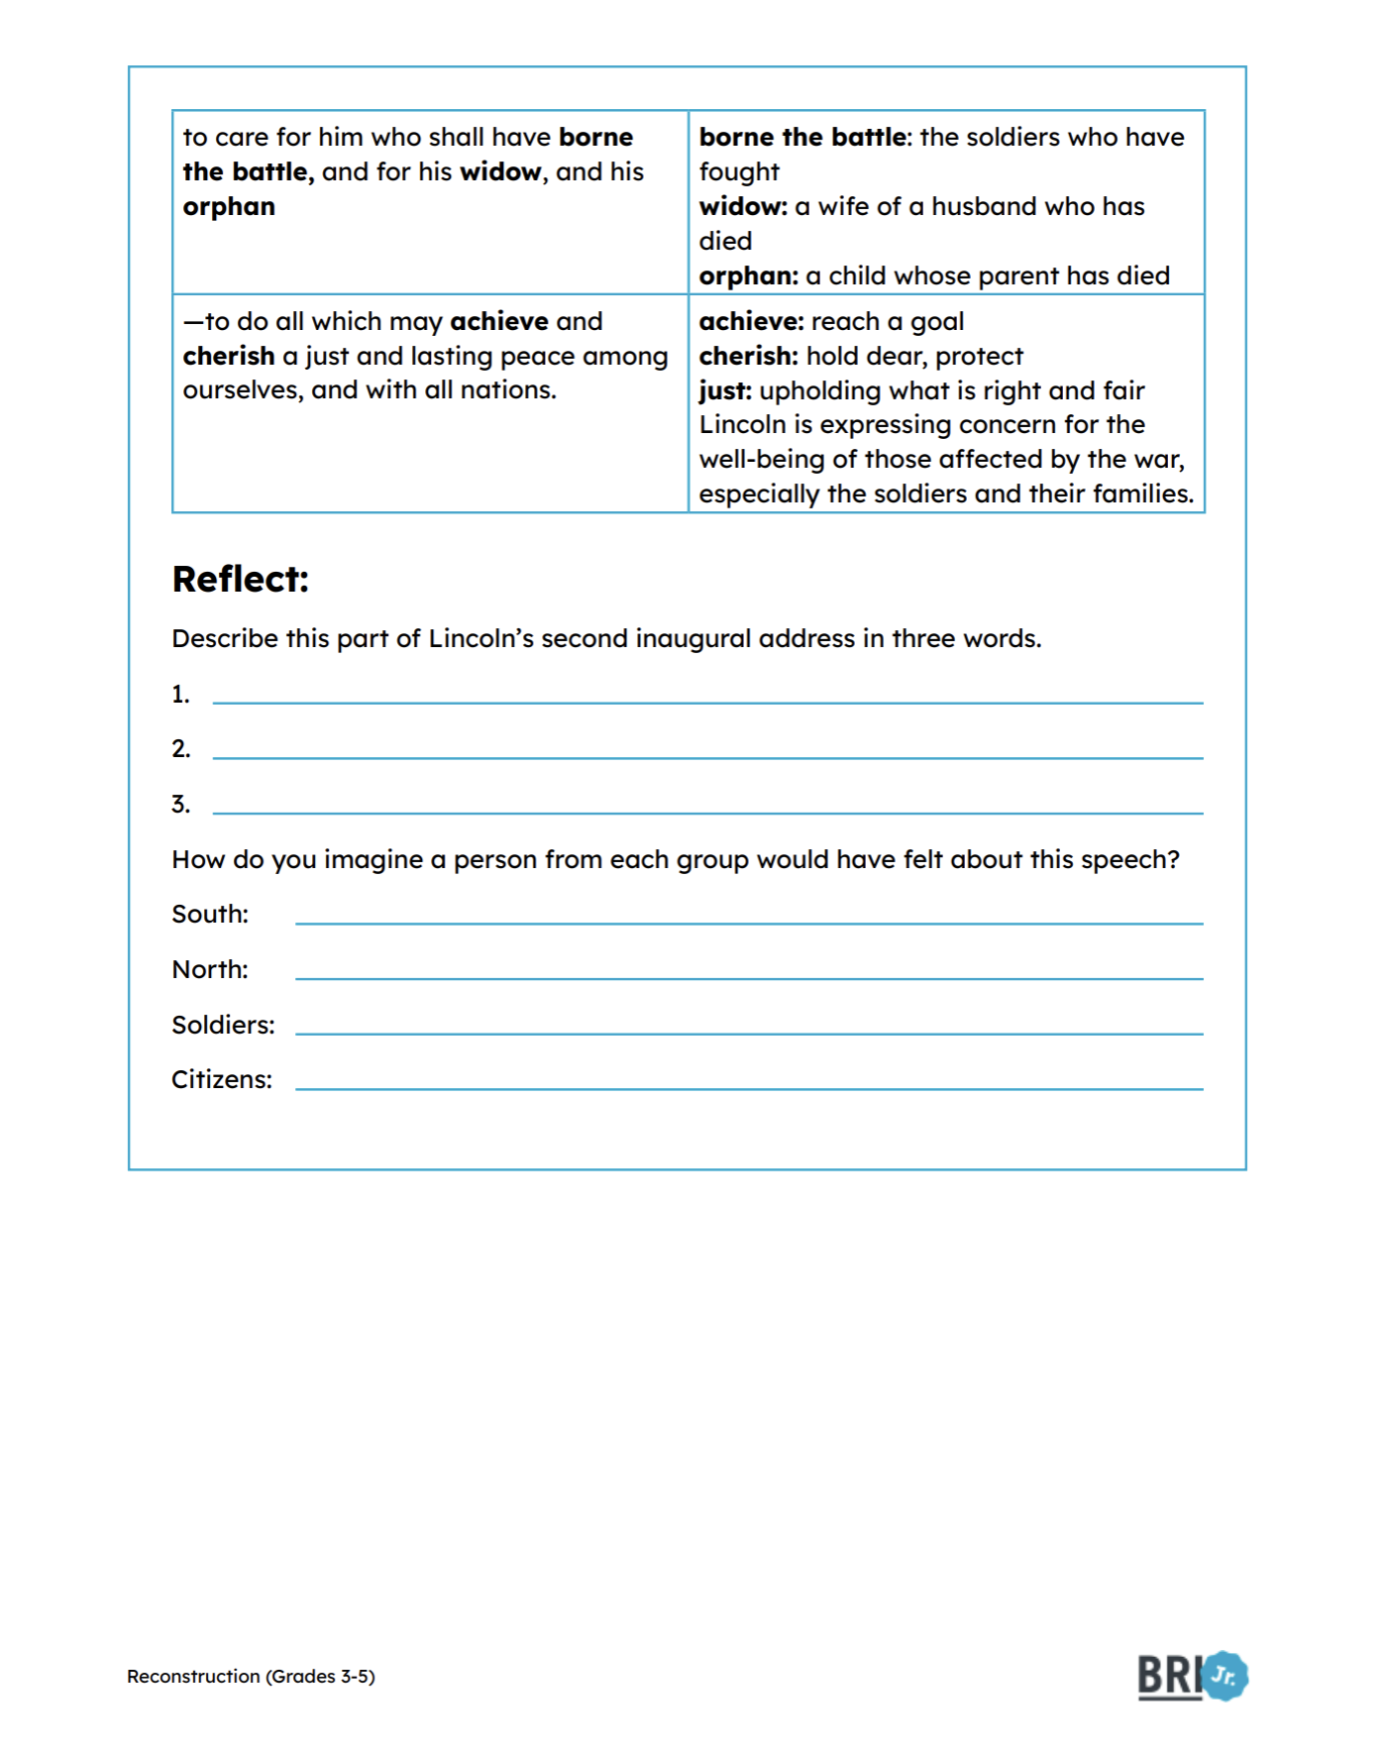
Text Investigation
View the image.
Read the primary source two times:
First read: Read the whole passage, focus on understanding what the text is saying.
Second read: Read the passage all the way through, as it would be spoken.

Slide 16
Discussion Questions
Lincoln said, "With malice towards none, with charity for all."
Did this surprise you?
How did your expectations compare to the words you used to describe Lincoln's speech?
Notes:
Lesson preview follows.

Slide 17
Discussion Prompts
The process of bringing the country back together after the Civil War was called "Reconstruction."
Many of the issues we identified on our bubble map needed to be addressed.
We will see how they succeeded in some ways, and faced challenges and failures as well.
Notes:
Preview the lesson with the discussion prompts.

Slide 18
Notes:
The following slides (19-26) correspond with the Explore #1 section of the lesson plan. Students will need Handout C. There is a formative assessment at the end of this section.

Slide 19
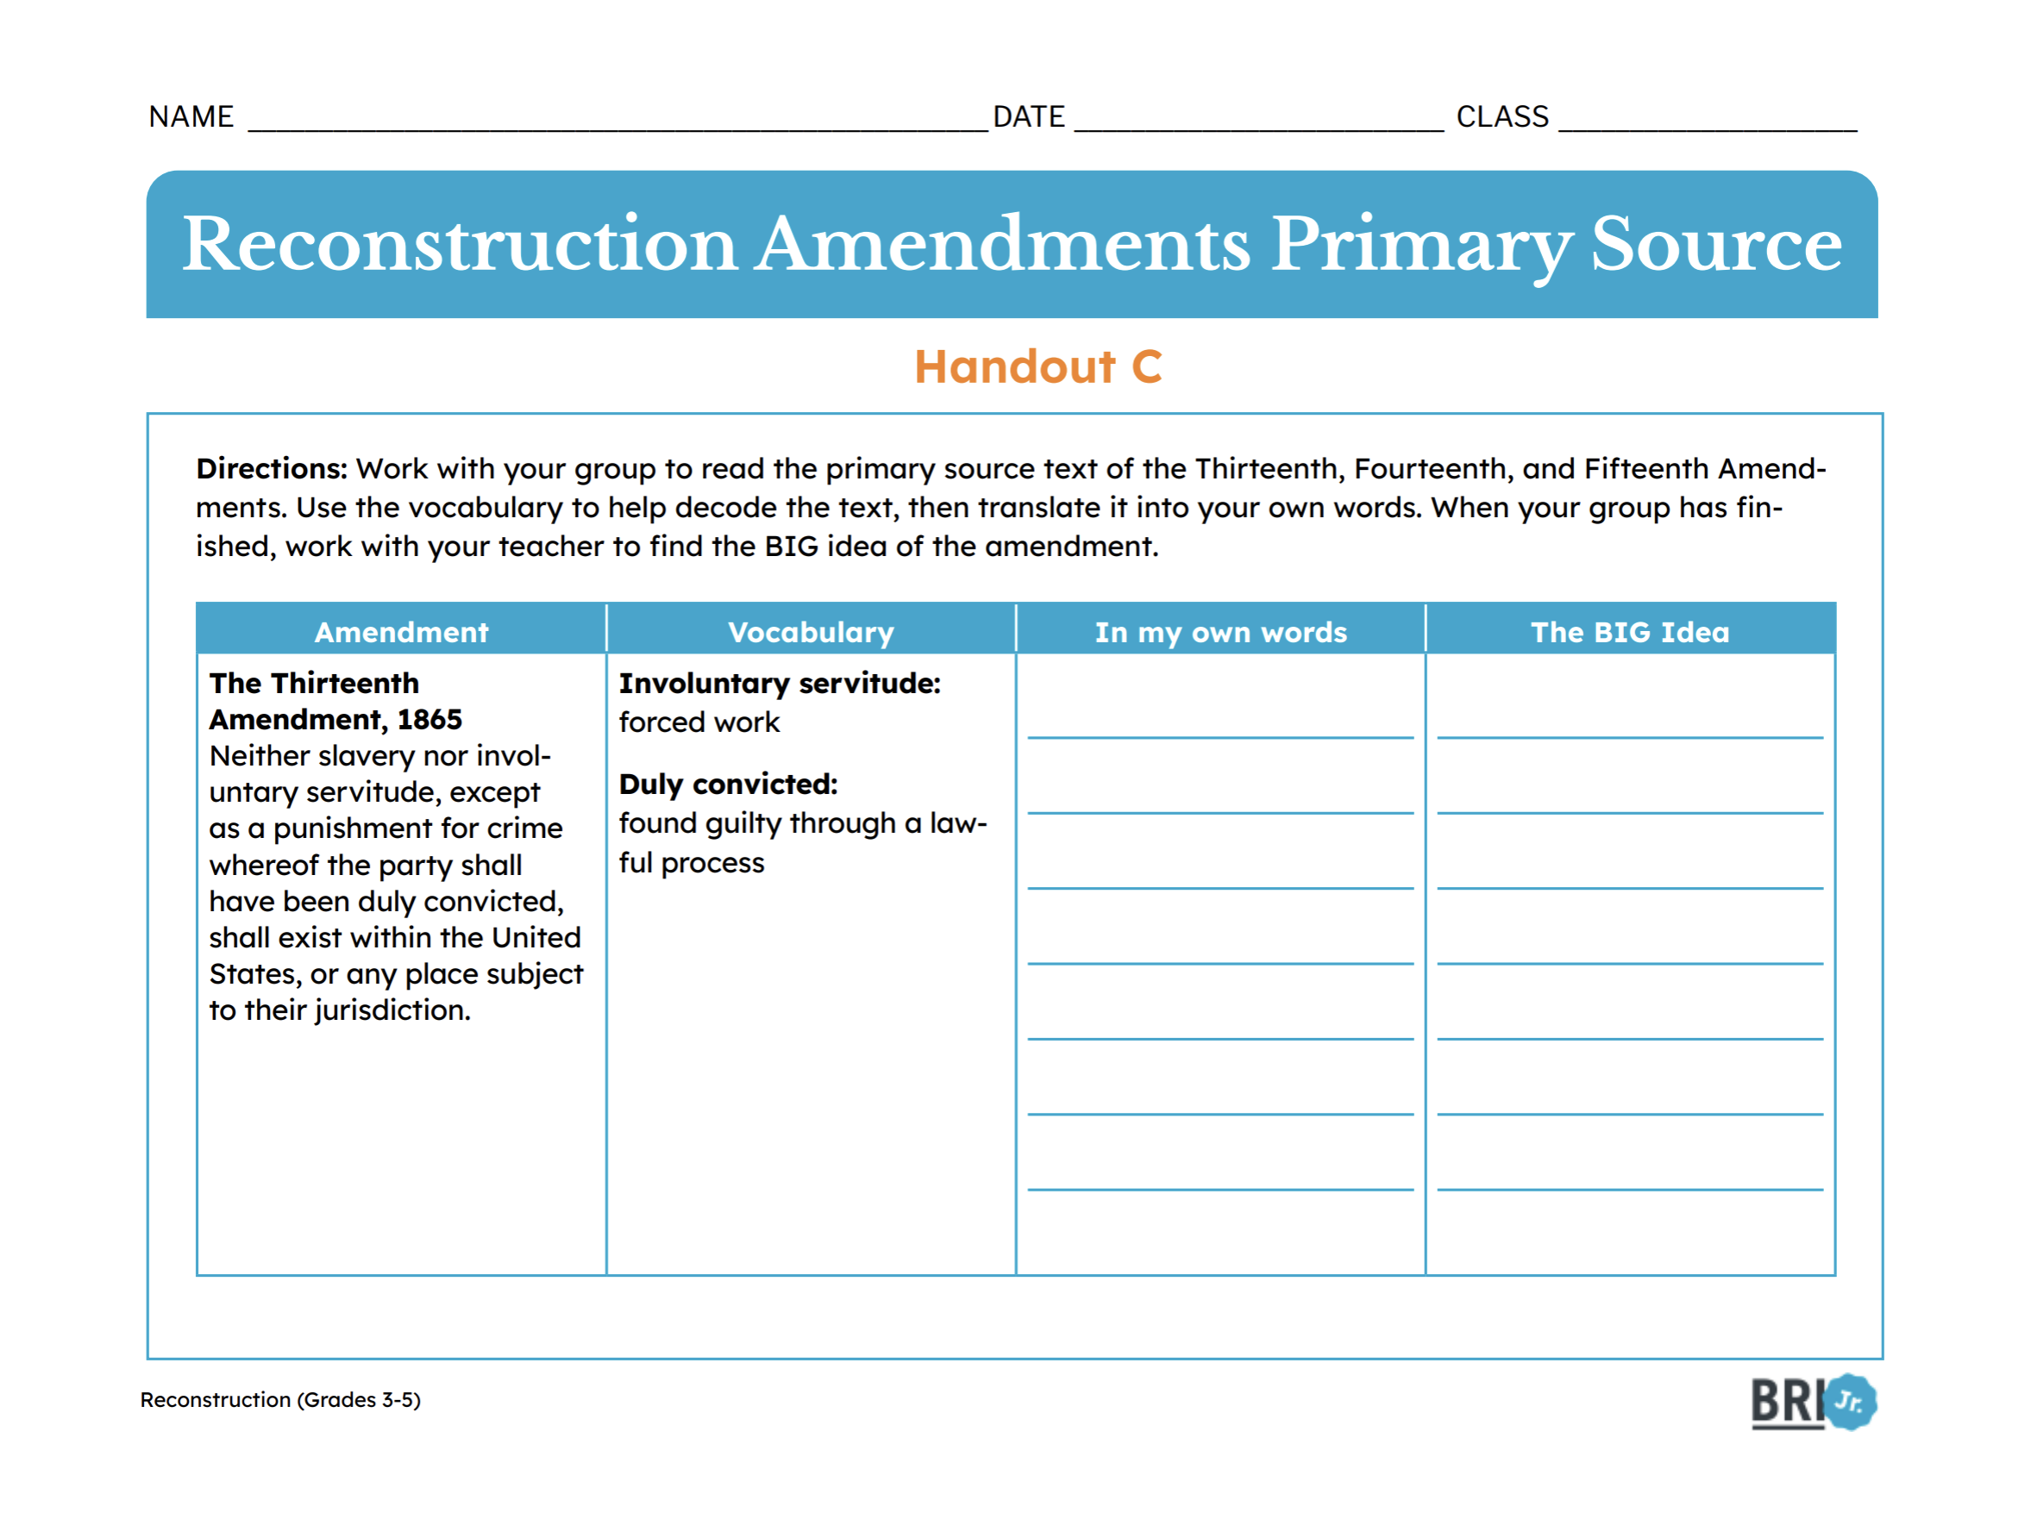
Text Investigation
Read the amendments in Handout C.
Once, you finish reading the Amendments, write them in your own words.
Remember to leave the Big Idea column blank!
Notes:
Give students 10 minutes to complete the reading and write the meanings. When the time has elapsed, bring the class back together. Have 1-3 students share their responses for the Thirteenth Amendment. Find common ideas among answers. Repeat these steps for the Fourteenth and Fifteen Amendments. Scaffolding support and teacher supports are located in the lesson plan. Discussion questions follow.

Slide 20
Discussion Questions
How is securing the right to vote a significant factor in ensuring or guaranteeing legal status and citizenship?
Consider the rights and privileges granted in the Reconstruction Amendments and to whom they are guaranteed.
Using the Bill of Rights Visual Guide, describe what changed with these amendments.
Notes:
Whole Group discussion. Answers to these questions are located in the lesson plan.
Bill of Rights Visual Guide can be found at https://billofrightsinstitute.org/resources/bill-of-rights-visual-guide

Slide 21
1
2
3
6
7
4
5
8
9
13
11
10
12
15
14
16
17
18
Notes:
Part 2: Image Investigation. More information and context for each part of the image is listed in the teacher lesson plan. Discussion questions follow.

Slide 22
Discussion Questions
How does this source show the hope and promise of Black freedom? What kinds of things does the artist see for the future of Black people now that they have the rights of citizenship?
Which areas of the primary source show Black Americans enjoying their natural rights?
Which areas of the primary source show justice for formerly enslaved Black Americans?
Consider the whole image. What is the artist trying to tell us?
Notes:
Use one or more of these discussion questions to help students reflect on the significance of the Fifteenth Amendment. Mini-lesson and the formative assessment follow.

Slide 23
Mini Lesson
It is important have a clear thesis statement.
A thesis is one sentence that answers a question or tells the main idea of your writing.
Question: What day is it?
THESIS
Today is Monday.
Notes:
Use this simplified example to model for students how to create a thesis statement.

Slide 24
Mini Lesson
We can support a thesis statement with evidence to make our reasoning stronger.
Examples of evidence are a primary source, data, or a quote.
Statement: Today is Monday.
EVIDENCE
The calendar shows today is Monday.
I heard it in the morning announcements.
Yesterday was Sunday.
Notes:
Use this simplified example to model for students how to support a statement with evidence. Explain to students that evidence can be strong or weak depending on the quality of the source. For the next activity, they will use strong primary sources selected to help them support a historical statement.

Slide 25
The principle of justice is having political order that protects the rights of all equally and treats everyone equally under the law.
The virtue of justice is upholding what is fair and right. Respecting the rights and dignity of all.
The Reconstruction amendments abolished slavery, made Black Americans citizens, and gave Black men the right to vote.
Notes:
Use the discussion prompts to review the definitions of justice and big idea of the reconstruction amendments from explore #1.

Slide 26
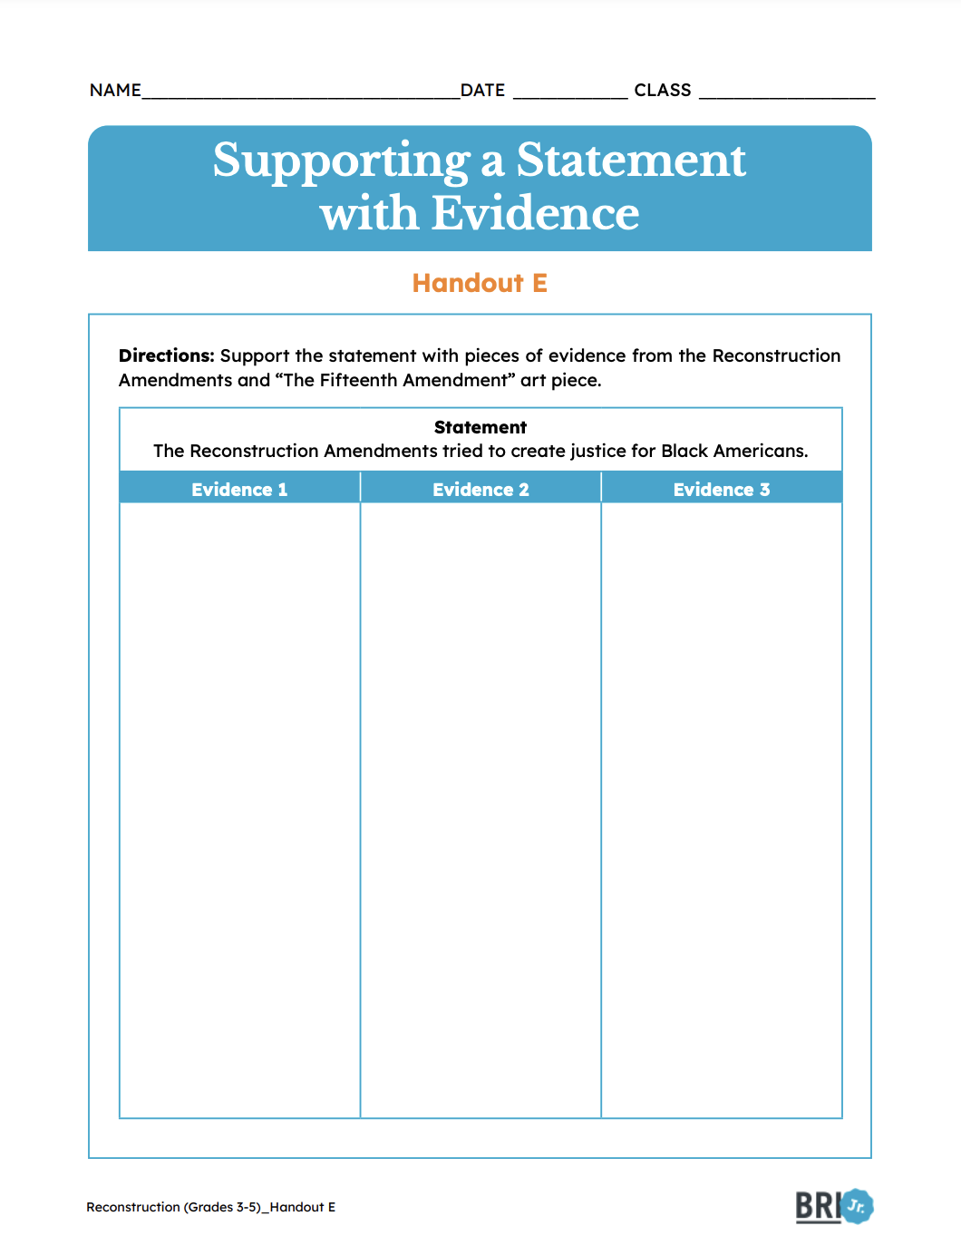
Assessment
Support the statement with three pieces of evidence from:
Reconstruction Amendments
The Fifteenth Amendment Art
Notes:
Select one piece of evidence to model the process for students. Then allow students to complete the other two by themselves. More information on evaluating student responses is found in the lesson plan.

Slide 28
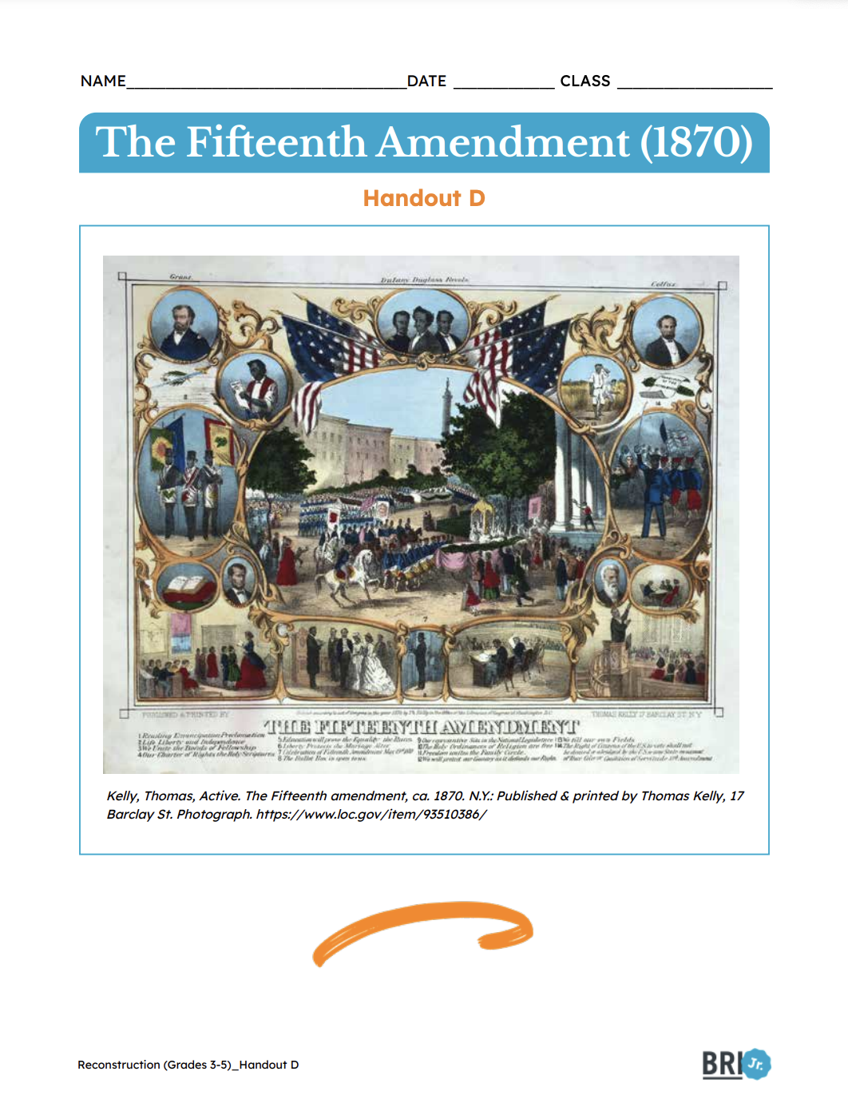
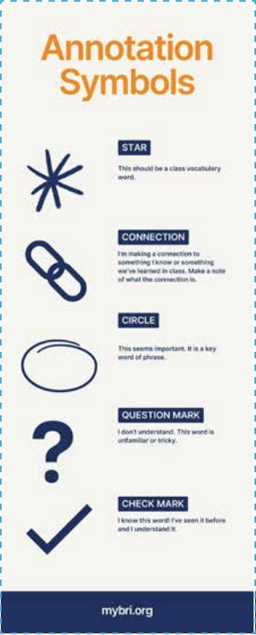
Reading and Annotation
You will need Handout F and Handout D and an annotation bookmark.
The first time you read, use the annotation symbols to mark your copy of Handout F.
Notes:
Review the annotation symbols and descriptions with students and prepare them to read and annotate approximately 10-15 minutes. Discuss what students annotated on their handouts when they have finished. Compare student answers looking for common themes and answering questions. Extend the discussion with prompts on the next slide.

Slide 29
Compare the optimism and hope of the art in Handout D with the realities of Reconstruction.
How did the goals of Reconstruction change over time from idea and promise to Lincoln’s plan, to Johnson’s plan?
What challenges did Black Americans face during the period of Reconstruction?
Notes:
For the first question, have students refer to Handout D.

Slide 30
Mini Lesson
Historical Analysis deals with studying evidence to try to gain a better understanding of the past.
What in the source proves my point?
What is the source telling me?
Notes:
More information for the mini-lesson is found in the teacher lesson plan. Use the prompts to overview what historical analysis is and how it differs from supporting an argument with primary sources.

Slide 31
Mini Lesson
Historical Analysis uses more than just what the source says to help understand the past.
Author's Purpose
Why was the source created?
Historical Context
What was happening when it was made?
Notes:
Use the prompts to overview what historical analysis is and how it differs from supporting an argument with primary sources.

Slide 32
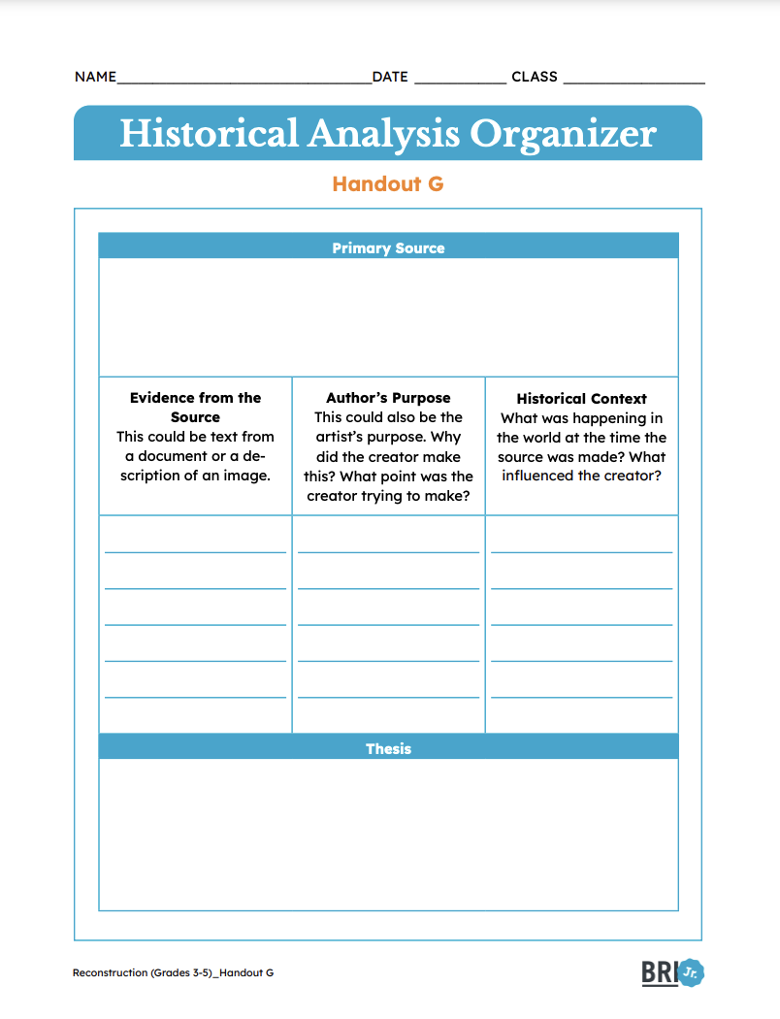
Mini Lesson
Example
How did President Lincoln want to Reconstruct the United States after the Civil War?
Handout B: Lincoln's Second Inaugural Address, 1865
With malice toward none; with charity for all; -Abraham Lincoln March 4, 1865
Explain how he wants to move forward with unity and justice after the Civil War.
His Second Inaugural Address, where he is taking the job of President again.
After the Civil War, President Lincoln wanted to lead the United States to rebuild with kindness.
Notes:
Use this example to help students see how to use a source to answer a question through historical analysis. A rubric and additional scaffolding supports are available in the teacher lesson plan.

Slide 33
You will need Handout G.
You may also use Handout D and F.
Notes:
Students will choose their topic on the next slide.

Slide 34
Choose one question to conduct your Historical Analysis.
How did the Reconstruction Amendments try to support justice for Black Americans?
How did the goals of bringing the country back together change over time?

Slide 36
Freedmen’s Bureau
Read and complete Handout H.
Notes:
Assign students Handout H independently or in groups of 2-3. Approximately 10-15 minutes. While students are working or before class, set up Chalk Talk stations.

Slide 37
Chalk Talk- Round 1
Written Responses Can Be:
Drawings
Writing
Ideas
Around the room, there are 4 writing stations with a question.
Approach the writing space one by one and add your written response silently.
Notes:
Students will let their writing speak for them in this silent activity. Students may want to have the lesson reading or handout E to reference as they plan their responses. You can also tell students to plan their writing in their seats and add it silently when they are ready if your classroom has space restraints.

Slide 38
Chalk Talk- Round 2
Written Responses Can Be:
Comments
Questions
Reflections
Return to the writing spaces around the room and take a moment to read your classmate's responses.
Approach the writing space one by one and add your written response silently.
Notes:
Students will let their writing speak for them in this silent activity. Students may want to have the lesson reading or handout E to reference as they plan their responses. You can also tell students to plan their writing in their seats and add it silently when they are ready if your classroom has space restraints.

Slide 39
Chalk Talk Questions
What was the purpose of the Freedmen’s Bureau?
What reactions were there to the Freedmen’s Bureau, both positive and negative?
What views are expressed in the primary sources? How do you know?
Why did the Freedmen’s Bureau ultimately end?
Notes:
This hidden slide can be displayed if students are planning their writing in their seat and need to see the prompts.

Slide 40
Discussion Questions
How do you think public perceptions of the Freedmen’s Bureau contributed to its successes and failures?
Part of the reason that the Freedmen’s Bureau was not very successful was because it lacked support from President Andrew Johnson. How could this have been different if Lincoln had been President?
W.E.B. Du Bois, a well-known Black writer stated this about Reconstruction: “The slave went free, stood a brief moment in the sun, then moved back again toward slavery.” How does this quote describe Reconstruction from the Black perspective?
Notes:
Du Bois is pronounced (dew-boys). Rather than simply answering the questions, use these discussion prompts to help students see patterns, common themes, and a diversity of perspectives that emerged in the Chalk Talk.

Slide 41
Mini Lesson
We can conduct a Historical Analysis.
Start with a primary source.
Identify the author’s purpose
Consider the historical context
Choose evidence from the source
Use all these pieces to write your thesis statement.
Notes:
Use this slide to review how to support a statement with evidence and define historical analysis from the previous mini-lessons. At this stage, you want to pull all of the pieces together to support students in creating a historical analysis thesis statement supported by evidence, including context and the author's purpose.
If you need to walk students through an example, consider the lesson reading as the source and the question “What was the Freedmen’s Bureau”.

Slide 42
Writing Prompt
Use Historical Analysis to answer the following question:
How do the successes and failures of the Freedmen’s Bureau illustrate the challenges of Reconstruction?
Notes:
Now students conduct their own historical analysis. They use the planning sheet and continue to write a paragraph or short essay. Approximately 15-20 minutes. A rubric for reflection and assessment follows. Scaffolding suggestions are available in the teacher lesson plan.

Slide 43
Rubric
Evidence of Mastery | Expectations | Room for Growth
 | Organization Writing has a clear message and can be understood easily.
 | Thesis The writing contains a thesis statement or main idea.
 | Evidence The writing uses at least 1 piece of text evidence.
 | Historical Analysis The writing uses historical context to support the thesis.
 | Content Writing is historically and factually accurate.
 | Conventions The student uses correct grammar, spelling, and punctuation.
 | Writing Quality Writing is neat and easy to read.
Notes:
This slide is currently hidden. However, if it would be beneficial for your students to see the rubric, you can reveal it.

Slide 45
Prompts
In your video, you will be doing a historical analysis for one of the following questions:
How did Reconstruction attempt to create a more just society and what challenges did it face?
How did the Reconstruction amendments try to create justice for Black Americans?
How did the goals of Reconstruction change over time?
How do the successes and failures of the Freedmen’s Bureau illustrate the challenges of Reconstruction?

Slide 46
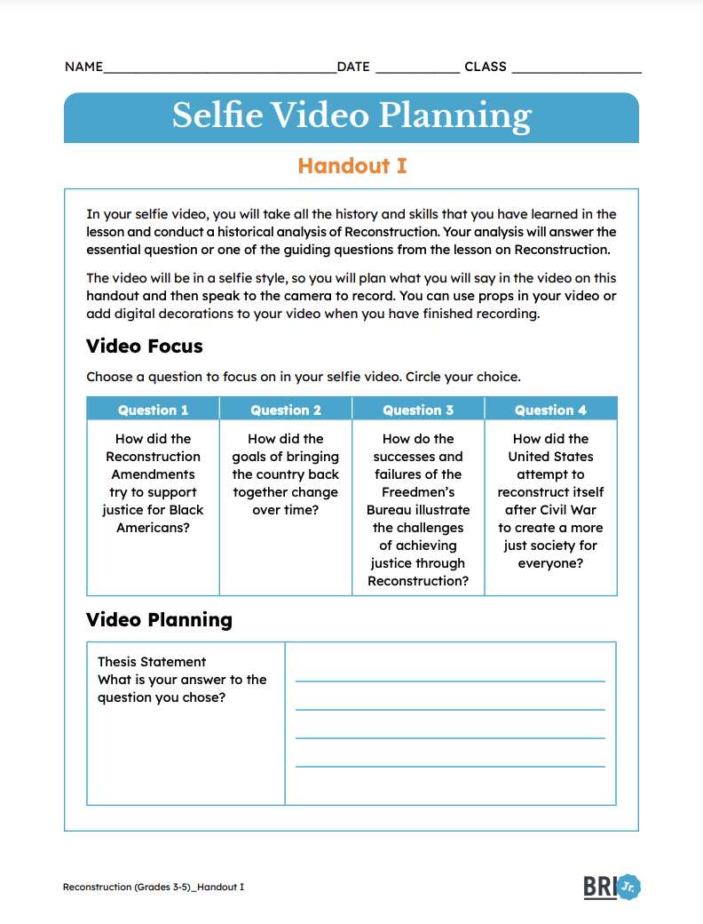
You will need Handout I.
Use the handout to plan your historical analysis selfie-video.
Notes:
Use this time to overview the video recording platform you have chosen for students to use if they are recording. The teacher lesson plan provides more scaffolding support, like finding videos to inspire your students. Students will need approximately an hour to plan and record their videos. This can be spread over several class periods or assigned as homework.

Slide 47
Rubric
Evidence of Mastery | Expectations | Room for Improvement
 | The thesis of the script is clear and and it is delivered in an engaging way.
 | The selfie video answers the lesson essential or guiding questions.
 | The video uses at least 1 piece of text evidence.
 | The video uses historical context to support the thesis.
 | The video is historically and factually accurate.
 | The video showcases the creativity and effort of the student.
Notes:
This slide is currently hidden. However, if it would be beneficial for your students to see the rubric, you can reveal it.

Slide 48
Notes:
The following slides (49-50) correspond with the Reflect section of the lesson plan. Students will need Handout H. Approximately 30-45 minutes. These are the final activities of the lesson plan.

Slide 49
Self-Assessment
Complete the Self-Assessment.
Notes:
Distribute Handout J for students to self-reflect. It can be done individually or with prompts from the teacher. Scaffolding support such as think-aloud can be modeled if students have no prior self-reflection experience. More detailed support on how to do this is provided in the lesson plan. ​

Slide 50
Artifact Show and Tell
Create an artifact related to the topics that we learned in this lesson.
An artifact can include:
A map
Tools
Clothing
Artwork
Be ready to explain the significance of your artifact.
Notes:
More information is found in the teacher lesson plan.

