Slide 1
The Urban Game

Slide 2
The Scene
The year is 1719. A group of settlers arrive in Boston, Massachusetts, to begin a new life. Sixteen families secure a grant of land from the Massachusetts Bay Company along the Merrimack River. They begin to establish a home for themselves.

Slide 3
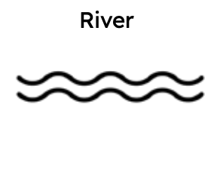
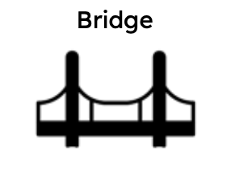
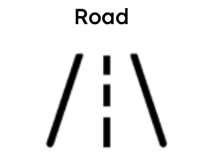
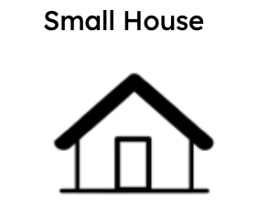
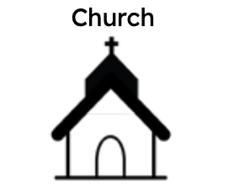
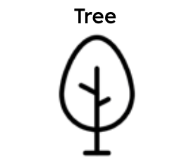
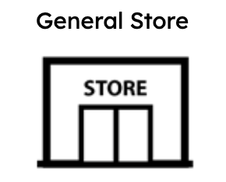
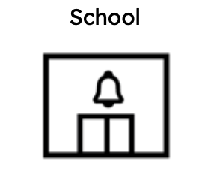
Set Up
On your paper, draw:
A river across your paper connecting east to west.
A bridge crossing the river.
2 roads. The 1st road should run up and down your paper and cross the river at the bridge. The 2nd road should run side to side on your paper. Neither road needs to be a straight line.
5 houses
1 church
At least 10 trees
1 school or general store

Slide 4
Round 1
It is now 1793. Your town has survived both the French and Indian War and the Revolution. Now in a time of peace, citizens have decided to construct another bridge across the river to open trade with Boston. This bridge increases trade in your town, now known as Manchester.

Slide 5
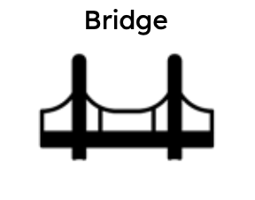
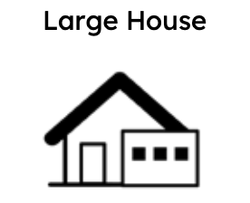
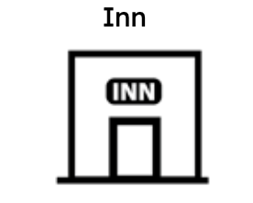
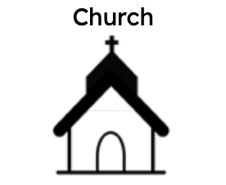
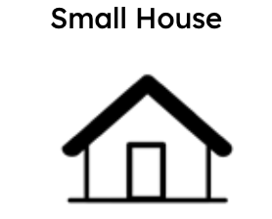
Round 1
Draw the second bridge. It must run across the river.
Enlarge one home since a citizen has increased their fortune from building the bridge.
Add 1 inn, 1 church, and 5 more small homes.

Slide 6
Round 2
It is now 1800. Inspired by an invention from England, a businessperson in your town decides to build a textile factory along the river. Powered by a water mill, the first factory for producing cloth or textiles is built in your town.

Slide 7
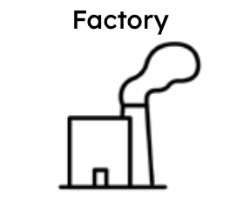
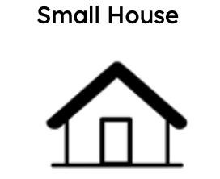
Round 2
Add 1 factory, without smoke. Remember, the textile factory must be placed next to the river.
Add 3 more houses for workers. Remove or “cut down” trees as needed.

Slide 8
Round 3
The mill owner in town has learned of the Scottish inventor James Watt’s improvements for the steam engine. The steam engine replaces the water mill as a power source for the mills.
The steam engine is far more efficient than the water mil, and it allows mills to be built away from the river as they can be powered by coal. Owners quicky replace their water frames with steam powered weaving and spinning machines creating job opportunities for women and immigrants while making more money overall.

Slide 9
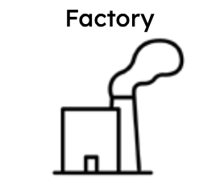
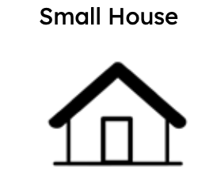
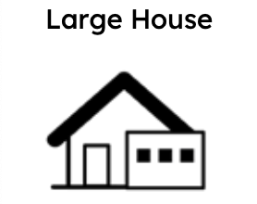
Round 3
Add 2 factories with smoke.
Add smoke to all other pre-existing factories.
Add small houses for workers.
Add 2 large homes for the wealthy factory owners.

Slide 10
Round 4
It is now 1840. Business owners and farmers seek new ways to get their goods to distant places. New forms of transportation are added to the existing canal and dirt roads for increased traffic in your town. New experiments with transportation using the power of a steam engine are tried. The most successful appears to be a steam engine that pulls a series of wagons or cars on an iron track. The first railroad is tested and proves to be quite effective.

Slide 11
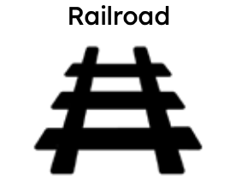

Round 4
Add 1 railroad line connecting all your factories. You may build additional railroad bridges only as needed.
Add 1 house for railroad builders.

Slide 12
Round 5
It is now 1860. As prosperity increases for mill owners, managers, and workers there is more leisure time and money available. New developments in the city indicate a rise in the standard of living.

Slide 13
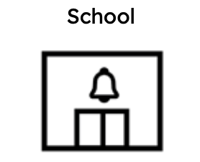
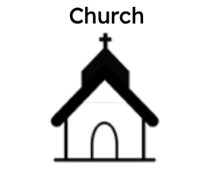
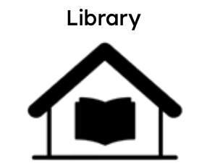


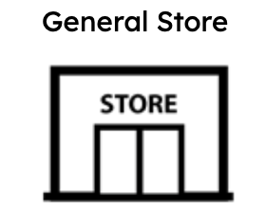
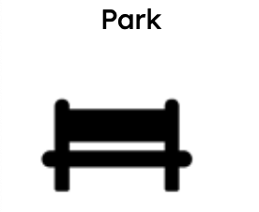
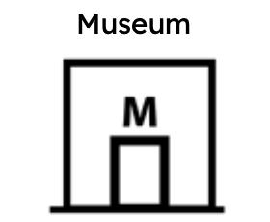
Round 5
Add a school, a church, and a library.
Add a general store, park, or museum.

Slide 14
Round 6
It is now 1880. Workers from the surrounding areas and immigrants pour into the town looking for work. The current housing situation is inadequate.

Slide 15
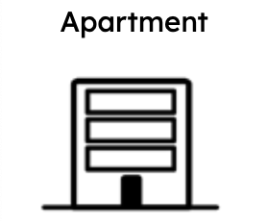
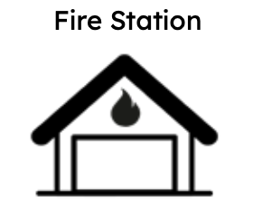
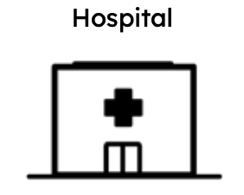
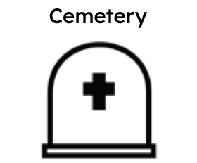
Round 6
Destroy 3 smaller homes and build an apartment building.
With the increased population comes increased accidents. Draw a fire station, hospital, and cemetery.

